Slide 1
302CEM logistics
Li Tung Leong 54777443
Ngai Yuen Ying 54827358
Lau Wut Shing 54777596
Leung Woon Hay Ryan 55441017

Slide 2
logistics_sample_format from manufacturers
Name | Data type | Constraint | Description | Examples
order_no | char(10) | PK | The order number | O0001 O0002
retailer_id | char(10) | FK | The individual id of retailer | R0001 R0002
logistics_id | char(10) | FK | The individual id of logistics | L0001 L0002
customer_address | varchar(200) |  | The address of the customer | YY Building YZ Building
contact_no | char(10) |  | The contact number of customer | 11111111 11111112
contact_person | varchar(50) |  | The name of the contact person | Mandy Man Mandy Ma

Slide 3
logistics_sample_format from manufacturers
Name | Data type | Constraint | Description | Examples
ship_date | datetime() |  | The shipment date | 30/1/2019 21:39 31/1/2019 21:39
Item_no | char(10) | FK | The item number | I0001 I0002
weight | double(7,5) |  | The weight of the item | 11.22222 88.00006

Slide 4
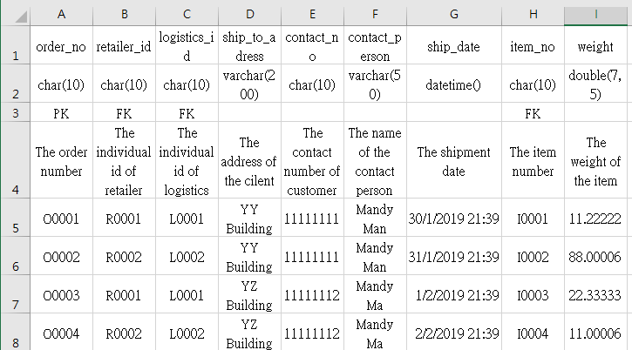
logistics_sample_data from manufacturers

Slide 5
logistics_sample_format from retailers
Name | Data type | Constraint | Description | Examples
order_no | char(10) | PK | The order number | O0001 O0002
retailer_id | char(10) | FK | The individual id of retailer | R0001 R0002
logistics_id | char(10) | FK | The individual id of logistics | L0001 L0002
customer_address | varchar(200) |  | The address of the customer | XX House XY House
contact_no | char(10) |  | The contact number of customer | 12345678 12345679
contact_person | varchar(50) |  | The name of the contact person | David Chan David Cha

Slide 6
logistics_sample_format from retailers
Name | Data type | Constraint | Description | Examples
expected_shipment_date | datetime() |  | The expected shipment date | 1/2/2019 23:59 2/2/2019 23:59
item_no | char(10) | FK | The item number | I0001 I0002
qty | int |  | The number of item quantity | 1 2

Slide 7
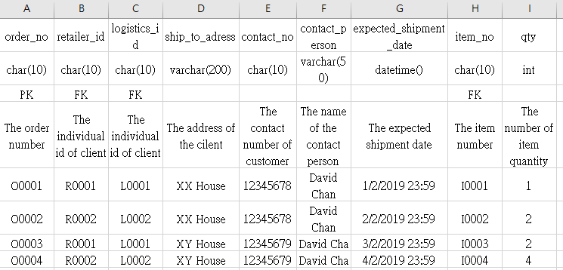
logistics_sample_data from retailers

Slide 8
End

